Slide 1
“Switching off circuit of scr”
Presented by-
Sanjay kumar
Branch : EN
Roll no :1802721082

Slide 2
Table of content
Introduction
V-I characterstics of Scr
Latching and holding current
Scr turn off method
1.Natural commutation
2.Forced commutation
a . Class A commutation
b . Class B commutation
c . Class C commutation
d . Class D Commutation
e . Class E commutation
Application
Advantage and disadvantage
Conclusion
References

Slide 3
Introduction
Silicon controlled rectifier :
A silicon controlled rectifier or semiconductor controlled rectifier is a four-layer solid-state current-controlling device. The principle of four-layer p–n–p–n switching was developed by Moll, Tanenbaum, Goldey and Holonyak of Bell Laboratories in 1956.[1] The practical demonstration of silicon controlled switching and detailed theoretical behavior of a device in agreement with the experimental results was presented by Dr Ian M. Mackintosh of Bell Laboratories in January 1958.[2][3] The name "silicon controlled rectifier" is General Electric's trade name for a type of thyristor. The SCR was developed by a team of power engineers led by Gordon Hall[4] and commercialized by Frank bell Gutzwiller in 1957.
Some sources define silicon-controlled rectifiers and thyristors as synonymous,[5] other sources define silicon-controlled rectifiers as a proper subset of the set of thyristors, those being devices with at least four layers of alternating n- and p-type material.[6][7] According to Bill Gutzwiller, the terms "SCR" and "controlled rectifier" were earlier, and "thyristor" was applied later, as usage of the device spread internationally.[8]

Slide 4
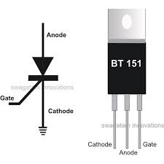
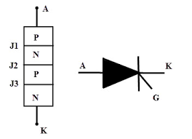

Slide 5
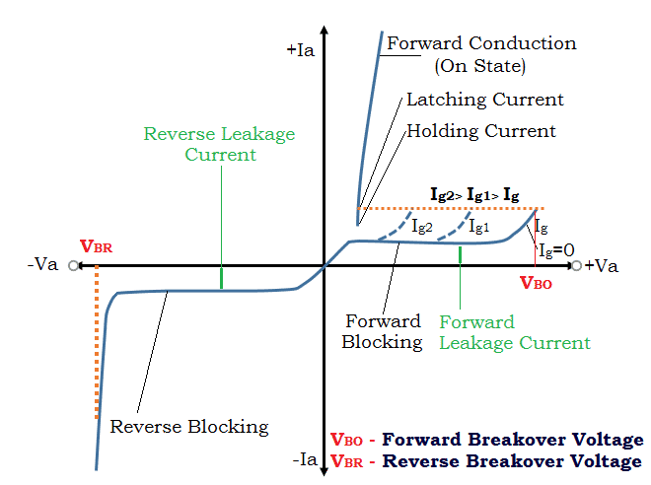
V-I characteristics of scr :

Slide 6
Latching and holding current:
Latching current :- It is the minimum anode current required to maintain the thyristor in the on -state immediately after a thyristor has been turned on and the gate signal has been removed.
Holding current :-It is the minimum anode current to maintain the thyristor in the on-state (if the forward anode current is reduced below holding current , a depletion region develops around junction J2 due to the reduced number of carriers and the thyristor is in blocking state).

Slide 7
SCR Turn OFF Methods :
The reverse voltage which causes to commutate the SCR is called commutation voltage. Depending on the commutation voltage located, the commutation methods are classified into two major types.
Those are :
1) Forced commutation
2) Natural commutation

Slide 8
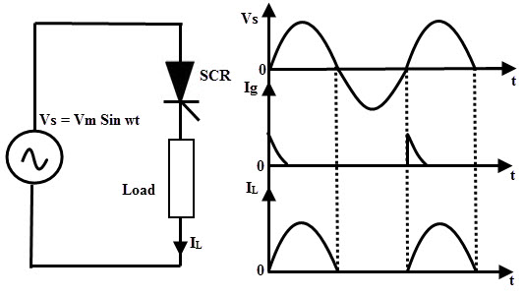
Natural Commutation:
In natural commutation, the source of commutation voltage is the supply source itself. If the SCR is connected to an AC supply, at every end of the positive half cycle the anode current goes through the natural current zero and also immediately a reverse voltage is applied across the SCR. These are the conditions to turn OFF the SCR
This method of commutation is also called as source commutation, or line commutation, or class F commutation. This commutation is possible with line commutated inverters, controlled rectifiers, converters and AC voltage regulators because the supply is the AC source in all these converters.

Slide 9
Forced Commutation :
In case of DC circuits, there is no natural current zero to turn OFF the SCR. In such circuits, forward current must be forced to zero with an external circuit to commutate the SCR hence named as forced commutation.
This commutating circuit consist of components like inductors and capacitors called as commutating components. These commutating components cause to apply a reverse voltage across the SCR that immediately bring the current in the SCR to zero

Slide 10
Class A Commutation :
This is also known as self commutation, or resonant commutation, or load commutation. In this commutation, the source of commutation voltage is in the load. This load must be an under damped R-L-C supplied with a DC supply so that natural zero is obtained.
The value of load resistance and commutating components are so selected that they forms a under damped resonant circuit to produce natural zero. When the thyristor or SCR is triggered, the forward currents starts flowing through it and during this the capacitor is charged up to the value of E.
on the L and C components. Once the capacitor is fully charged (more than the supply source voltage) the SCR becomes reverse biased and hence the commutation of the device.

Slide 11
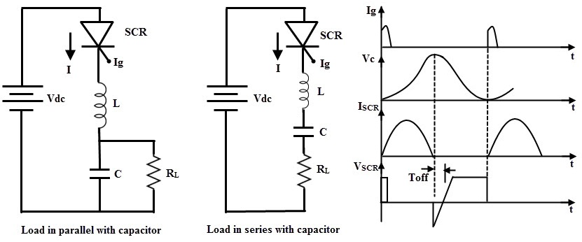
Circuit diagram of class A commutation

Slide 12
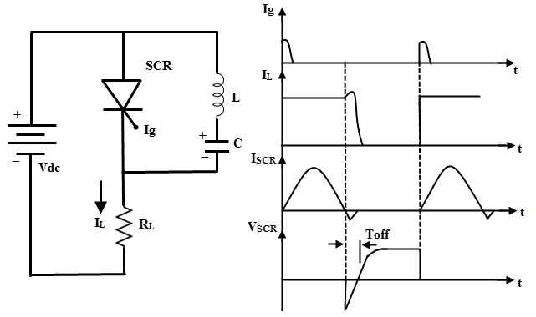
Class B Commutation :
as This is also a self commutation circuit in which commutation of SCR is achieved automatically by L and C components, once the SCR is turned ON. In this, the LC resonant circuit is connected across the SCR but not in series with load in case of class A commutation and hence the L and Component do not carry the load current.
When the DC supply is applied to the circuit, the capacitor charges with an upper plate positive and lower plate negative up to the supply voltage E. When the SCR is triggered, the current flows in two directions, one is through E+ – SCR – R – E- and another one is the commutating current through L and C components.

Slide 13
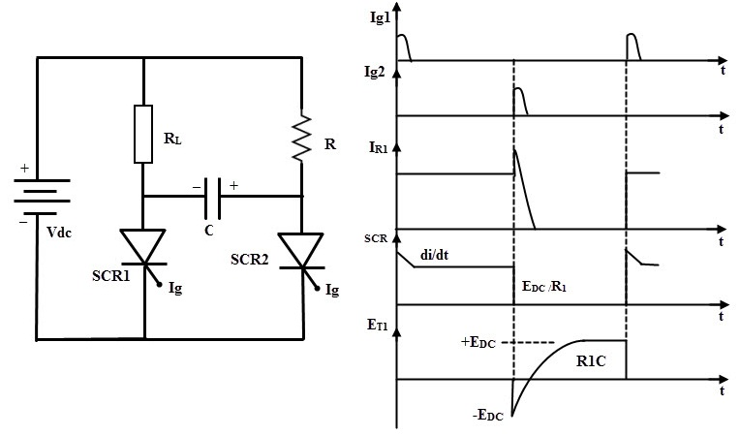
Class C Commutation :
In this commutation method, the main SCR is to be commutated is connected in series with the load and an additional or complementary SCR is connected in parallel with main SCR. This method is also called as complementary commutation.
In this , SCR turns OFF with a reverse voltage of a charged capacitor.
Initially, both SCRs are in OFF state so the capacitor voltage is also zero. When the SCR1 or main SCR is triggered, current starts flowing in two directions, one path is E+ – R1 – SCR1 – E- and another path is the charging current E+ – R2- C+ – C- SCR1 – E- . Therefore, the capacitor starts charging up to the value of E.

Slide 14
When the SCR2 is triggered, SCR is turned ON and simultaneously a negative polarity is applied across the SCR1. So this reverse voltage across the SCR1 immediately causes to turn OFF the SCR1. Now the capacitor starts charging with a reverse polarity through the path of E+ – R1- C+ – C- SCR2 – E-. And again, if the SCR 1 is triggered, discharging current of the capacitor turns OFF the SCR2.

Slide 15
Class D Commutation:
. This is also called as auxiliary commutation because it uses an auxiliary SCR to switch the charged capacitor. In this, the main SCR is commutated by the auxiliary SCR
When the supply voltage E is applied, both SCRs are in OFF state and hence the capacitor voltage is zero. In order to charge the capacitor, SCR2 must be triggered first. So the capacitor charges through the path E+ – C+ – C- – SCR2- R- E-.
. When the capacitor is fully charged the SCR2 becomes turned OFF because no current flow through the SCR2 when capacitor is charged fully. If the SCR1 is triggered, the current flows in two directions; one is the load current path E+ – SCR1- R- E- and another one is commutation current path C+ – SCR1- L- D- C.

Slide 16
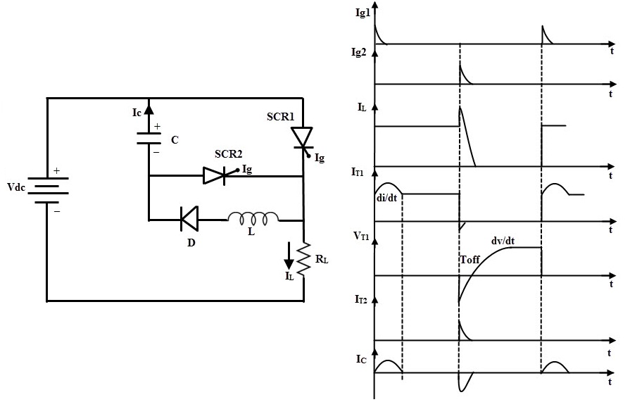
Circuit diagram of class D commutation

Slide 17
Class E Commutation:
This is also known as external pulse commutation. In this, an external pulse source is used to produce the reverse voltage across the SCR
If the SCR need to be commutated, pulse duration equal to the turn OFF time of the SCR is applied. When the SCR is triggered, load current flows through the pulse transformer.If the pulse is applied to the primary of the pulse transformer, an emf or voltage is induced in the secondary of the pulse transformer

Slide 18
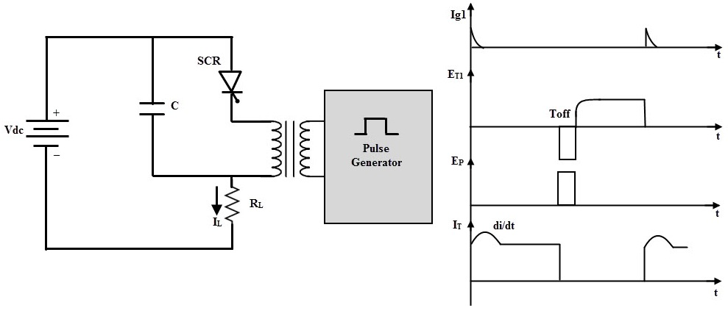
Circuit diagram of class E commutation

Slide 19
Applications of scr:
The silicon controlled rectifier (SCR) is used in AC voltage stabilizers.
It is used in choppers.
The silicon controlled rectifier (SCR) is used for power control.
It is used for DC circuit breaker.
Silicon control rectifier (SCR) is used in battery charger
The SCR is used in pulse circuit.
. It is used for AC power control with solid relay.

Slide 20
Advantages :
1. It can be protected with the help of fuse.
2. It is easy to turn ON.
3. The Triggering circuit for silicon controlled rectifier (SCR) is simple.
4. It is simple to control.
5. It cost is low.
6. It is able to control AC power

Slide 21
Disadvantages :
In AC circuit, it needs to be turned on each cycle.
It cannot be used at higher frequencies.
The gate current cannot be negative.
The silicon controlled rectifier (SCR) is unidirectional devices, so it can control power only in DC power during positive half cycle of AC supply. Thus only DC power is controlled with the help of SCR

Slide 22
Conclusion :
1. The silicon controlled rectifier behave as switch with two states i.e. either non-conducting or conducting.
2. There are three modes in which scr operates, those are: forward blocking, forward conduction and reverse blocking mode.
3. The scr cannot be turned off through the gate so to open the scr, applied voltage must reduce to zero.
4. Scr can be used for both AC and DC switching application.

Slide 23

Thank you

